Slide 1


ORGANISED BY
DEPARTMENT OF OPHTHALMOLOGY
ALL INDIA INSTITUTE OF MEDICAL SCIENCES, BATHINDA
“UNITE FOR A
GLAUCOMA-FREE WORLD”
MARCH 9 -15, 2025
ORGANISED BY
DEPARTMENT OF OPHTHALMOLOGY
ALL INDIA INSTITUTE OF MEDICAL SCIENCES, BATHINDA

Slide 2
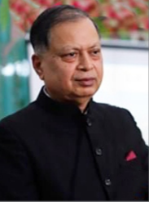
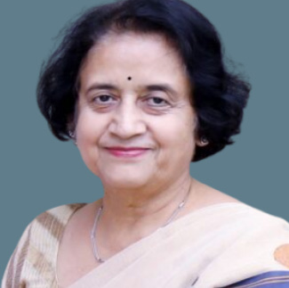
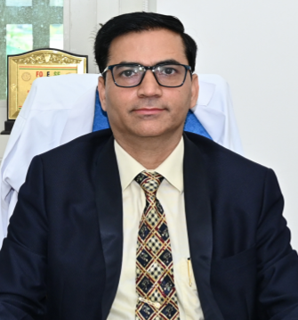
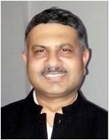
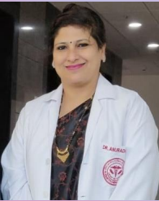
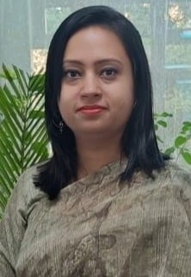
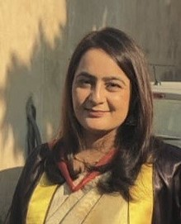
PATRON
Prof. (DR.) D.K. SINGH
Founder Executive Director AIIMS, Bathinda
Prof.(DR.)MEENU SINGH
Executive Director
AIIMS Bathinda
CO-PATRON
DR. AKHILESH PATHAK
Dean Academics,
AIIMS, Bathinda
CO-PATRON
DR. RAJIV KUMAR GUPTA
Medical Superintendent,
AIIMS, Bathinda
ORGANISING CHAIRPERSON
DR. ANURADHA RAJ
Professor and Head
Department of Ophthalmology
ORGANISING SECRETARY
DR. VANDANA SHARMA
Assistant Professor
Department of Ophthalmology
ORGANISING SECRETARY
DR. SABIA HANDA
Assistant Professor
Department of Ophthalmology
ORGANISING MEMBERS
Dr. Anurag Singla (SR)
Dr. Easther Daziine (JR)
Dr. Sahil Jain (JR)
Dr. Chetna Saini (JR)
Dr. Tanmay Gaidhani (JR)
Dr Suvashika Dhingra(JR)

Slide 3

SCHEDULE OF
EVENTS
Awareness talk at Peripheral outreach centre
Awareness talk at OPD Reception
Awareness talk at IPD Reception
Poster competition
QUIZ competition
CME On Glaucoma

